Slide 1

Automata Theory CSCI 3304 Second Semester 2020-2021
Dr. Basem O. F. Alijla

Slide 2
Reduction of definitions
Convert the terms in the hypothesis to their definition
A set S is finite, if there exist an integer n such that S has exactly n elements
|| S || = n
If S and T are both subsets of some set U , T is the complement of S with respect to U
S⋃T = U
S⋂ T = ∅

Slide 3
Reduction of definitions
Theorem 1.5 :
If S is finite subset , of some infinite set U , and T be complement of S then T is infinite
Proof
New | Original
There is an integer n such that ||S|| = n | S is finite
For no integer p is ||U|| = p | U is infinite
S⋃T = U and S⋂ T = ∅ | T is the complement

Slide 4
Proof by contradiction:
Assume the conclusion is false
Prove the opposite of one of the given statement of hypothesis
It is impossible for all part of the hypothesis to be true and for conclusion to be true and for conclusion to be false at the same time
The conclusion is true whenever the hypothesis is true

Slide 5
Proof by contradiction:
Opposite the Conclusion :
T is finite → || T|| = m
Given → S is finite → ||S|| = n
T is the complement of S → S⋃T = U and S⋂ T = ∅
||U|| = n + m element of U , since n + m is an integer , then U is
finite contradict the given that U is infinite

Slide 6
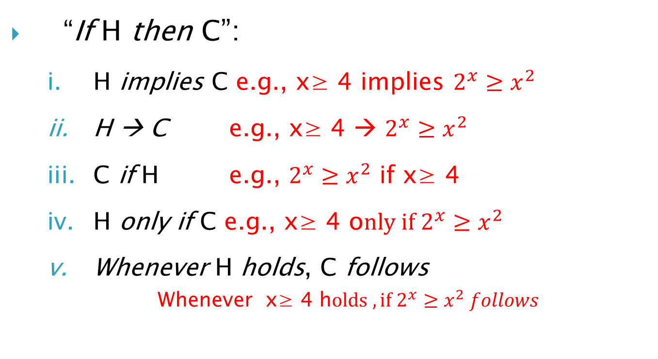
Different ways of saying the same thing
“If H then C”:
H implies C e.g., x≥ 4 implies $2^{x}≥x^{2}$
H → C e.g., x≥ 4 → $2^{x}≥x^{2}$
C if H e.g., $2^{x}≥x^{2}$ if x≥ 4
H only if C e.g., x≥ 4 o$nly if 2^{x}≥x^{2}$
Whenever H holds, C follows
Whenever x≥ 4 h$olds , if 2^{x}≥x^{2} follows$

Slide 7
“If-and-Only-If” statements
“A if and only if B” (A <--> B)
(if part) if B then A ( <= )
(only if part) A only if B ( => ) (same as “if A then B”)
“If and only if” is abbreviated as “iff”
i.e., “A iff B”
If part : “if B then A “
Only-if part : “if A then B”
You have to prove the both direction

Slide 8
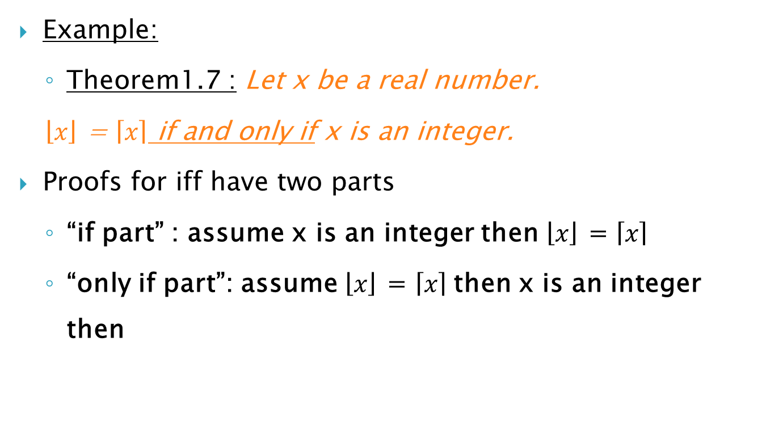
“If-and-Only-If” statements (cont.)
Example:
Theorem1.7 : Let x be a real number.
$\left\lfloor x\right\rfloor$ = $\left\lceil x\right\rceil$ if and only if x is an integer.
Proofs for iff have two parts
“if part” : assume x is an integer then $\left\lfloor x\right\rfloor$ = $\left\lceil x\right\rceil$
“only if part”: assume $\left\lfloor x\right\rfloor$ = $\left\lceil x\right\rceil$then x is an integer then

Slide 9
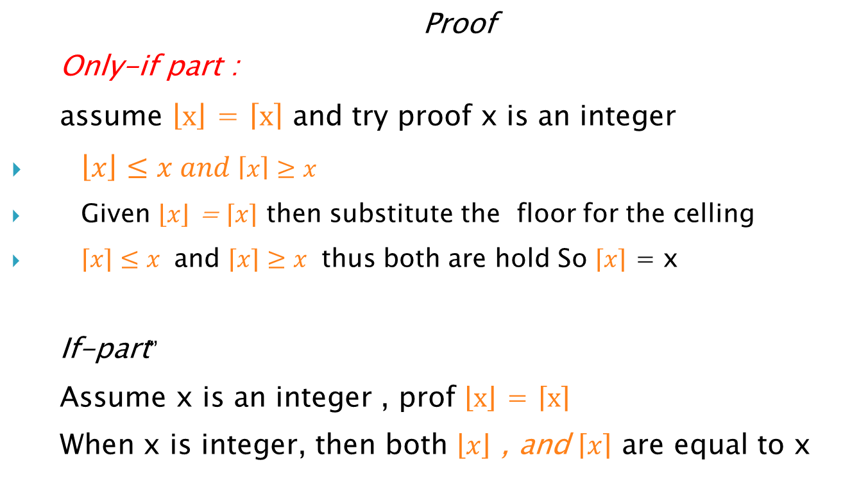
“If-and-Only-If” statements (cont.)
Proof
Only-if part :
assume $\left\lfloor x\right\rfloor$ = $\left\lceil x\right\rceil$ and try proof x is an integer
$\left\lfloor x\right\rfloor ≤x and \left\lceil x\right\rceil ≥x$
Given $\left\lfloor x\right\rfloor$ = $\left\lceil x\right\rceil$ then substitute the floor for the celling
$\left\lceil x\right\rceil ≤x$ and $\left\lceil x\right\rceil ≥x$ thus both are hold So $\left\lceil x\right\rceil$ = x
If-part”
Assume x is an integer , prof $\left\lfloor x\right\rfloor$ = $\left\lceil x\right\rceil$
When x is integer, then both $\left\lfloor x\right\rfloor$ , and $\left\lceil x\right\rceil$ are equal to x

Slide 10
Proving equivalences about sets
Languages are set of strings, and we asked to prove that two languages constructed by two different ways are the same.
E = F
Theorem 1.9 : commutative law of union
The union of two sets R and S in either order,
R ⋃ S = S ⋃ R,
E = R ⋃ S , F = S ⋃ R
E = F
Proof that if x is in E then x is in F
Proof that id x is in F then x is in E
Notes:
إثبات التكافؤ حول المجموعات
اللغات عبارة عن مجموعة من الجمل ، وقد طلبنا إثبات أن لغتين تم إنشاؤهما بطريقتين مختلفتين متماثلتين.
ه = واو
نظرية 1.9: القانون التبادلي للنقابات
اتحاد مجموعتين R و S في أي من الترتيب ،
ص ⋃ S = S ⋃ R ،
E = R ⋃ S ، F = S R
ه = واو
دليل على أنه إذا كانت x في E فإن x تكون في F.
دليل على أن المعرف x موجود في F ثم x موجود في E.

Slide 11
Proving equivalences about sets
Theorem 1.10 : distribution law of union or intersection
R ⋃ ( S ⋂T ) = (R ⋃S ) ⋂(R ⋃ T )
Two sets of expression involves :
E = R ⋃ ( S ⋂T ) and F = (R ⋃S ) ⋂(R ⋃ T )
If part : Assume x is in E , and show it is in F
Justification | Statement
Given | X is in R ⋃ ( S ⋂T ) | 1.
By 1 and intersection def. | X is in R or x is in S ⋂T | 2.
By 2 and intersection def. | X is in R or x is in both S and T | 3.
By 3 and union def. | X is in R ⋃ S | 4.
By 3 and union def. | X is in R ⋃ T | 5.
By 4 , 5 and intersection def. | X is in (R ⋃ S ) ⋂ (R ⋃ T) | 6.
Notes:
النظرية 1.10: قانون توزيع الاتحاد أو التقاطع
R ⋃ (S ⋂T) = (R ⋃S) ⋂ (R ⋃ T)
مجموعتان من التعبير تتضمن:
E = R ⋃ (S ⋂T) و F = (R ⋃S) ⋂ (R ⋃ T)
إذا كان الجزء: افترض أن x موجود في E ، وأظهر أنه في F.

Slide 12
Proving equivalences about sets
Only-If part
E = R ⋃ ( S ⋂T ) and F = (R ⋃S ) ⋂(R ⋃ T )
Assume x is in F , and show it is in E
Justification | Statement
Given | X is in (R ⋃ S ) ⋂ (R ⋃ T) | 1.
By 1 and intersection def. | X is in R ⋃ S | 2.
By 1 and intersection def. | X is in R ⋃ T | 3.
By 2, 3 and reasoning about union | X is in R or x is in both S and T | 4.
By 4 and intersection def. | X is in R or x is in S ⋂ T | 5.
By 5 and union def. | X is in R ⋃ (S ⋂ T) | 6.

Slide 13
The contrapositive
The contrapositive of statement
if H then C is if not C then not H
Two are either true or false , prove either one to prove the other.
Four cases
H and C are both true
H true and C false
C true and H false
H and C are both false

Slide 14
The contrapositive
If-then : if H then C
There is one way to make an if-then statement false, hypothesis must be true and conclusion false (case 2)
Contrapositive: if not C then not H
Statement to be false, (not C) must be true
, and (not H) must be false
This is only in case 2

Slide 15
Counterexample
Try to prove the theorem, and if we cannot , try to prove its statement is false.
Theorem and observation
Theorems are statement about infinite number of cases.
It is sufficiently to show that alleged theorem is false in any one case in order to show it is not a theorem.
Easer to prove that it is not a theorem that to prove it is a theorem

Slide 16
Counterexample
Alleged theorem 1.13.
All primes are prime ( if integer x is prime then x is odd ).
Disproof: the integer 2 is prime, but it is even.
a, and b are positive integer, a mod b is reminder
r = a mod b [0- b-1],
a = q * b + r for some integer q.

Slide 17
Counterexample
Alleged theorem 1.14.
There is no pair of integer a and b such that:
a mod b = b mod a
Case 1 : a <b
Case 2 : b < a
Case 3 : a = b
Disproof.
( a < b), then a mod b = a, q =0, r = a = 0 * b + a
(a> b ), b mod a < a [0 - a-1],
a mod b < b mod a So it is impossible a mod b = b mod a
Case 3 : a = b,
x mod x = 0 for any x, then a mod b = b mod a

Slide 18
Counterexample
Alleged theorem 1.15.
There is no pair of integer a and b such that:
a mod b = b mod a iff a = b
If part:
a = b then x mod x = 0
Only if part :
a mod b = b mod a
Proof by contradiction:
a ≠ b
a < b , a mod b = a
b < a , b mod a < a

Slide 19
The Central Concepts of Automata Theory

Slide 20
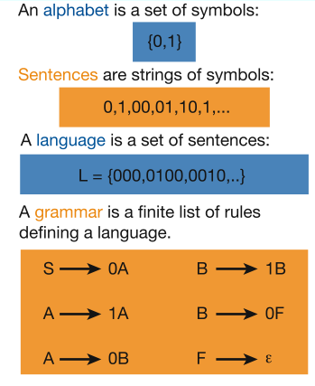
Languages & Grammars
Or “words”
Languages: “A language is a collection of sentences of finite length all constructed from a finite alphabet of symbols”
Grammars: “A grammar can be regarded as a device that enumerates the sentences of a language” - nothing more, nothing less
N. Chomsky, Information and Control, Vol 2, 1959
Image source: Nowak et al. Nature, vol 417, 2002

Slide 21
Alphabet
An alphabet is a finite, non-empty set of symbols
We use the symbol ∑ (sigma) to denote an alphabet
Examples:
Binary: ∑ = {0,1}
All lower case letters: ∑ = {a,b,c,..z}
Alphanumeric: ∑ = {a-z, A-Z, 0-9}
DNA molecule letters: ∑ = {a,c,g,t}
…

Slide 22
Strings
A string or word is a finite sequence of symbols chosen from ∑
Empty string is ε (or “epsilon”)
Length of a string w, denoted by “|w|”, is equal to the number of (non- ε) characters in the string
E.g., x = 010100 |x| = 6
x = 01 ε 0 ε 1 ε 00 ε |x| = ?
xy = concatenation of two strings x and y

Slide 23
Powers of an alphabet
Let ∑ be an alphabet.
∑^{k} = the set of all strings of length k
∑* = ∑⁰ U ∑¹ U ∑² U …
∑⁺ = ∑¹ U ∑² U ∑³ U …

Slide 24
Languages
L is a said to be a language over alphabet ∑, only if L ⊆ ∑*
➔ this is because ∑* is the set of all strings (of all possible length including 0) over the given alphabet ∑
Examples:
Let L be the language of all strings consisting of n 0’s followed by n 1’s: L = {ε, 01, 0011, 000111,…}
Let L be the language of all strings of with equal number of 0’s and 1’s:
L = {ε, 01, 10, 0011, 1100, 0101, 1010, 1001,…}
Definition: Ø denotes the Empty language
Let L = {ε}; Is L=Ø?
Canonical ordering of strings in the language
NO

Slide 25
The Membership Problem
Given a string w ∈∑*and a language L over ∑, decide whether or not w ∈L.
Example:
Let w = 100011
Q) Is w ∈ the language of strings with equal number of 0s and 1s?

